Slide 1

Introduction into Luigi
27.12.2019 Spitzer

Slide 2
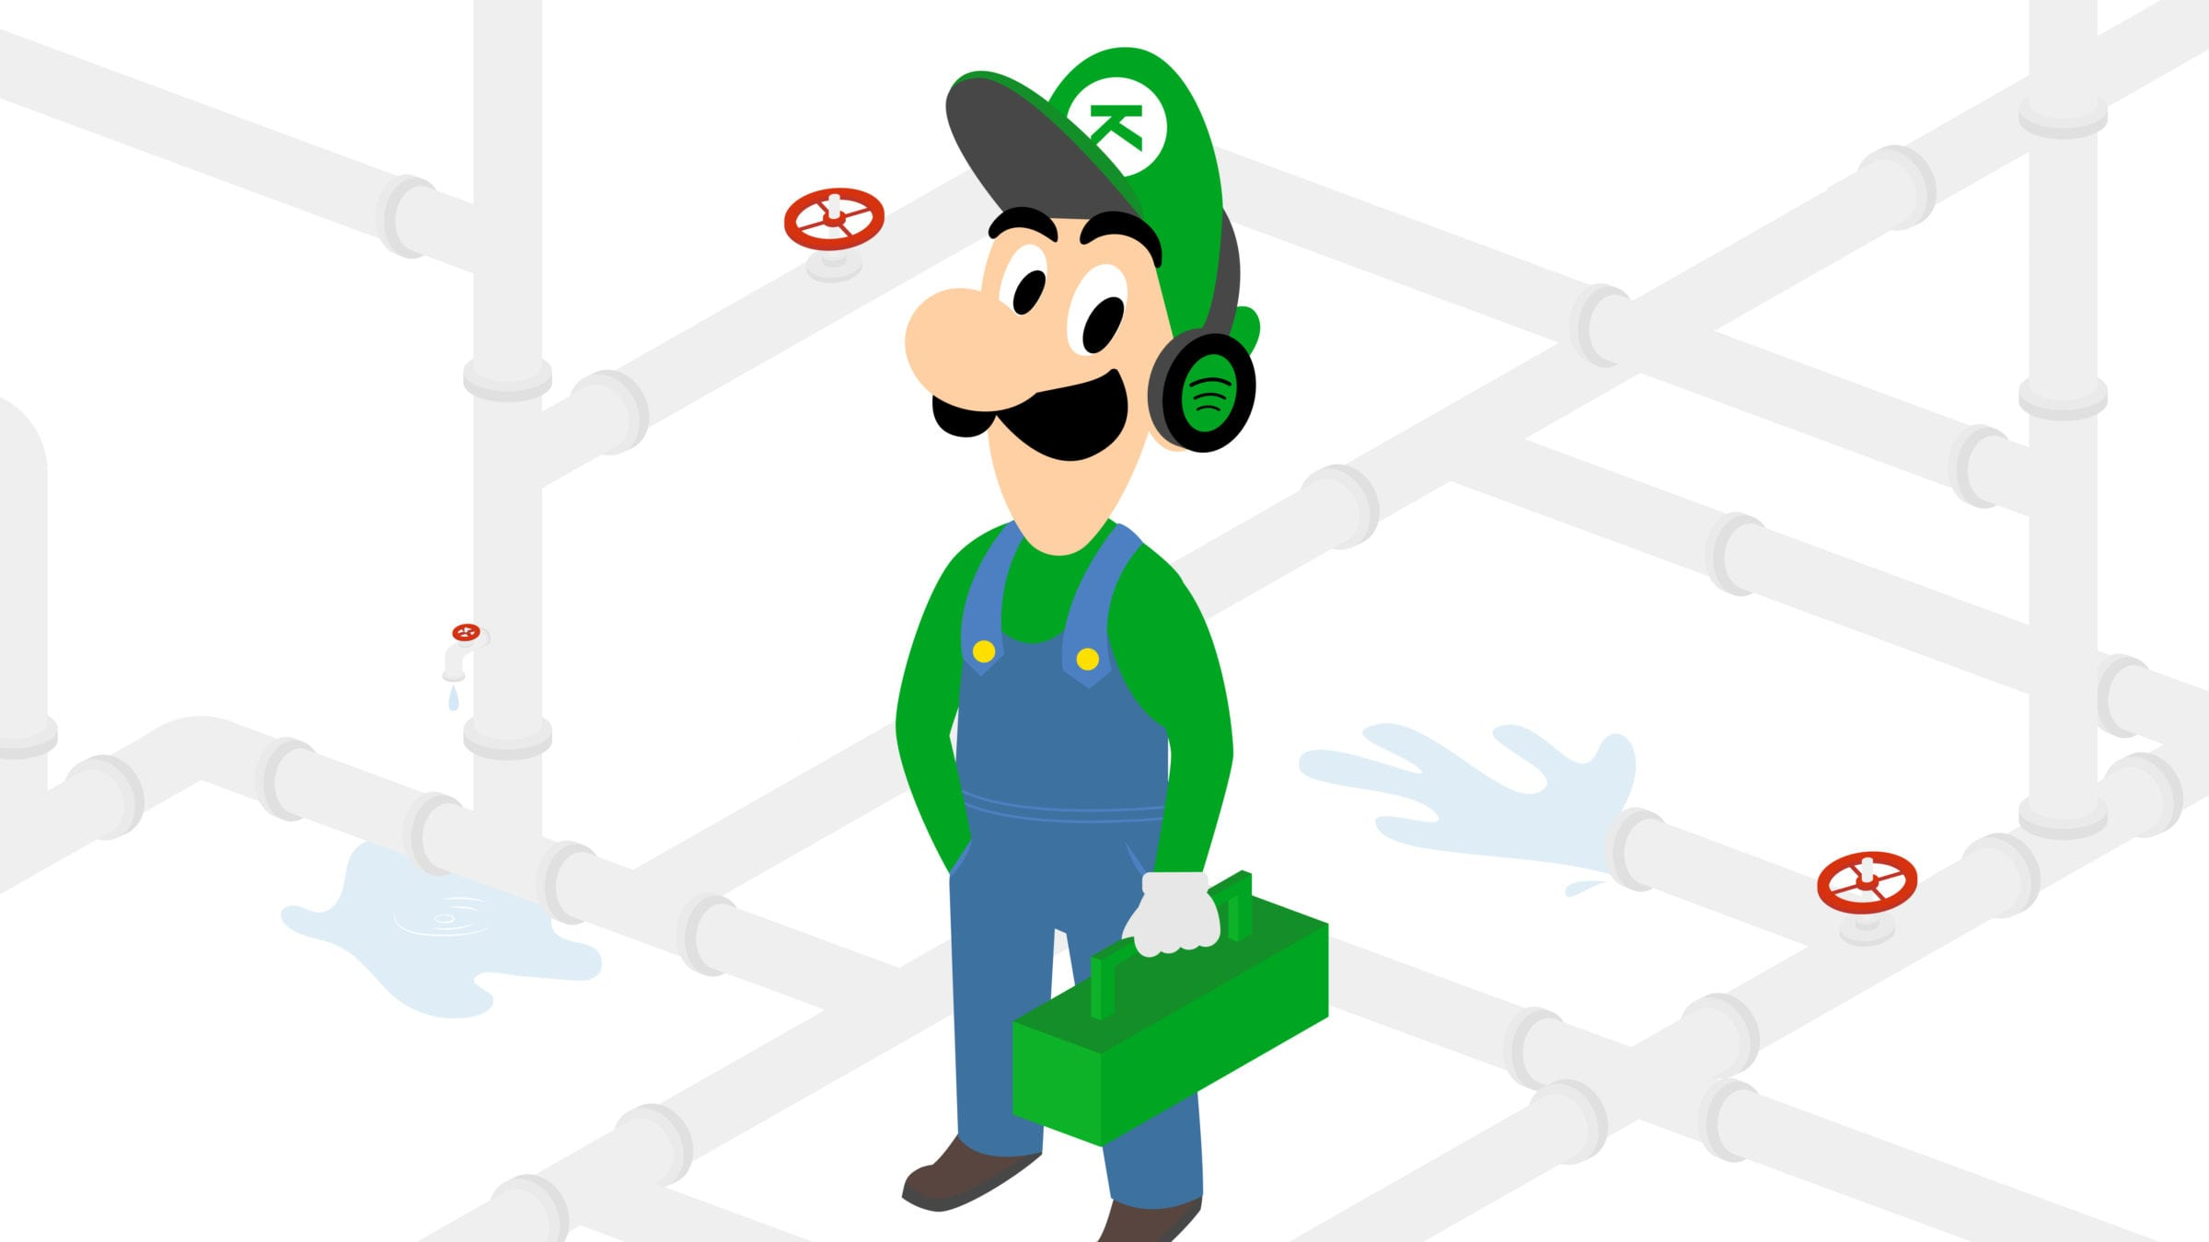
What is Luigi
Pipeline Library completely in Python
Solve pipeline problems associated with long-running batch process
Handles dependency resolution, workflow management and visualization, …¹
Stich many Tasks together
Hadoop support build in¹
Designed by Spotify
Notes:
1: https://github.com/spotify/luigi

Slide 3
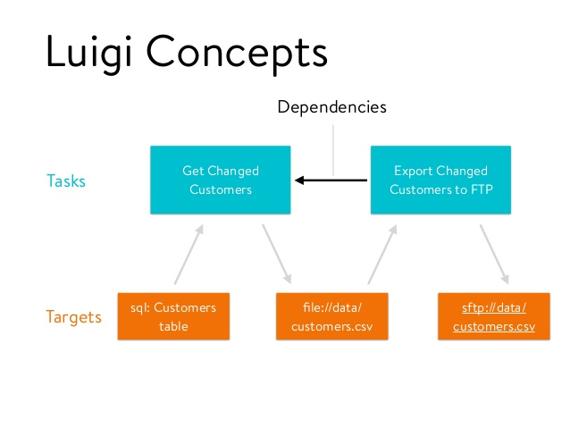
Structure
Tasks and Targets (main Building Blocks)

Slide 4
Elements of Luigi
Targets
Tasks (Nodes)
Parameters

Slide 5
Targets
File usually outputted by a Task
Examples:
LocalTarget, HdsfTarget → They map on a file on the local drive or a file in HDFS
Luigi.contib.s3.S3Target, luigi.contrib.mysqldb.MySqlTarget

Slide 6
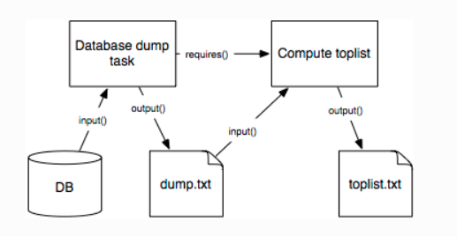
Tasks
Performs computations and consumes Targets, which are generated by other Tasks.
Elements:
Requires() …Calls an other Luigi Task, to define dependencies between Tasks.
Run() … Methods to be executed should be written here.
Output() … Returns one or more Taget objects (CSV file, …)
Input() … Helper method that returns the corrsponding Target classes for each Task dependency

Slide 7
Task cont
A Task could be:
Machine Learning Algorithms
Hive query
Hadoop job in Java
Spark job in Scala or Python
…

Slide 8
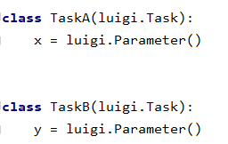
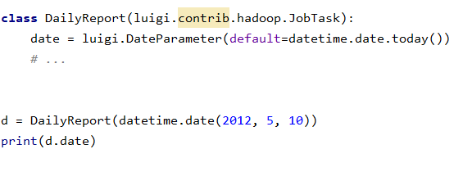
Parameter
Can be seen as a constructor for each Task.
Types:
Subclasses: DateParameter, DateIntervalParameter, IntParameter, FloatParameter, etc.
Not necessary to specify the type - if you don`t care you can simple use the base class Parameter
Notes:
The Task class corresponds to some type of job that is run, but in general you want to allow some form of parameterization of it. For instance, if your Task class runs a Hadoop job to create a report every night, you probably want to make the date a parameter of the class. See Parameters for more info.

Slide 9
Live Demo
Python – Preprocessing Pipeline with Luigi
Notes:
Switch to Pycharm to show the Preprocessing Pipeline

Slide 10
Recap
Preprocessing
requires(): Load files (CSV) which should be preprocessed.
run(): This method calls all preprocessing steps defined.
output(): Write out the preprocessed dataframe into a CSV file.

Slide 11
Recap cont
LocalTarget … Build in class that makes it easy to read/write from/to the local filesystem. It also makes all file operations atomic, which is nice in case your script crashes for any reason.

Slide 12
Execution of Tasks

Slide 13
Execution of Tasks
Process of workflow is backword
First the last task will be executed, then they will be executed in the correct order
Why? → To avoid to re-run a task which is already satisfied

Slide 14
Execution of Tasks cont
Start
Task C
Task B
Task A
Task B
Task C
End
No Error

Slide 15
Execution of Tasks cont
Start
Task C
Task B
Task A
(done)
Task B
(error)
Task C
End (error)
Run 1
Start
Task C
Task B
Task C
End
Run 2
error but no need to run Task A entirely

Slide 16
Luigi at Spotify
What they use it for
Examples

Slide 17
What do Spotify use Luigi for?
Music Recommendations
A/B Testing
Top Lists
Label Reporting
Dashboards

Slide 18

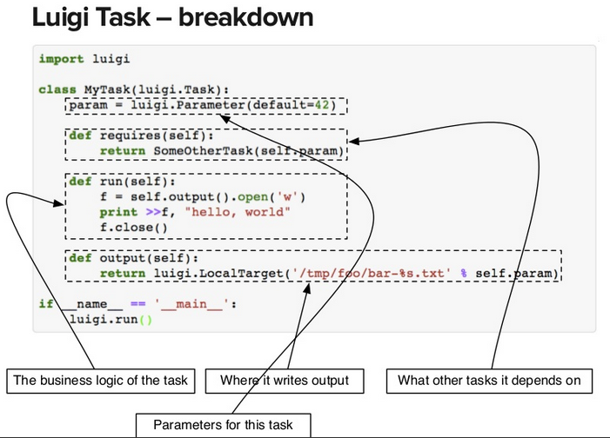
Luigi Task -Breakdown
Notes:
https://www.slideshare.net/erikbern/luigi-presentation-nyc-data-science

Slide 19
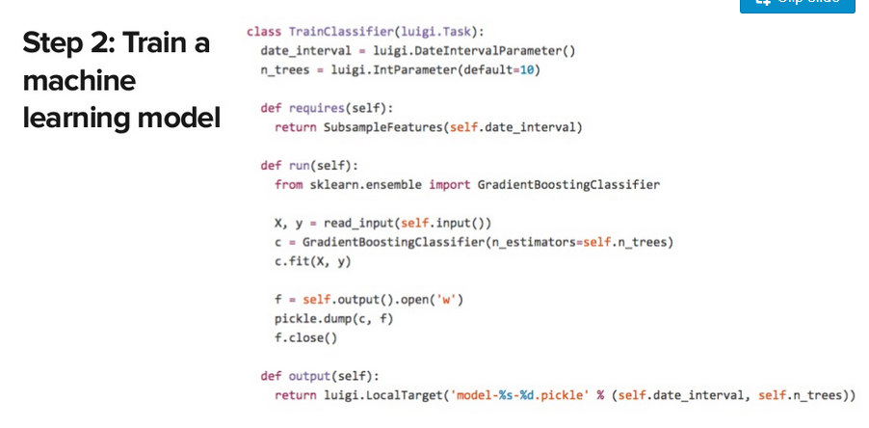
Example Step 2: Train a ML-Model
Notes:
https://www.slideshare.net/erikbern/luigi-presentation-nyc-data-science

Slide 20
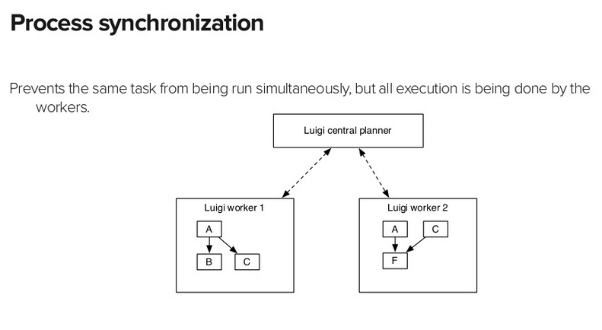
Process Synchronization
Notes:
https://www.slideshare.net/erikbern/luigi-presentation-nyc-data-science

Slide 21
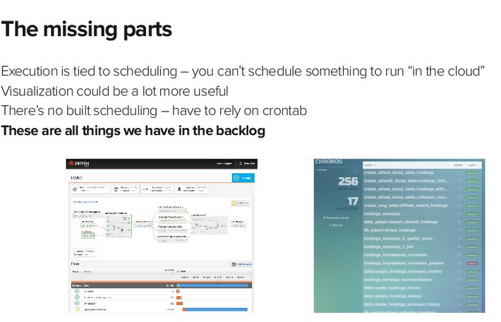
Missing Parts of Luigi
2014
Run Luigi in the Cloud
Backlog
Notes:
https://www.slideshare.net/erikbern/luigi-presentation-nyc-data-science
Slide 63

Slide 22
Additional Information
Visualizer Page
Dependency Graph Example
Example Aritist

Slide 23
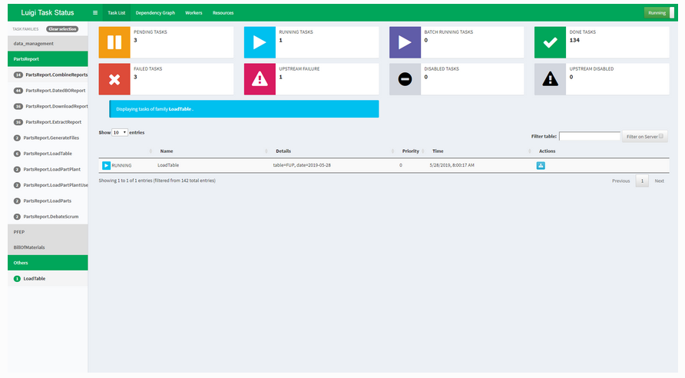
Visualiser Page

Slide 24
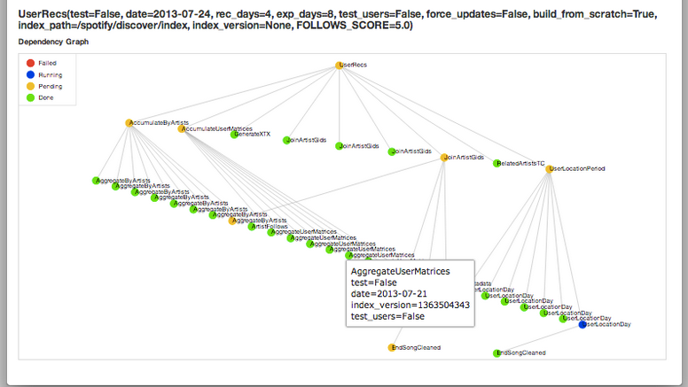
Dependency Graph Example

Slide 25
Example Artist
https://luigi.readthedocs.io/en/stable/example_top_artists.html#running-this-locally

Slide 26
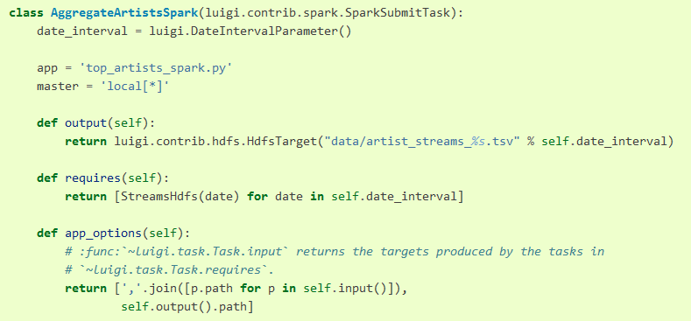
Step 1b – Aggregate artists with Spark

Slide 27
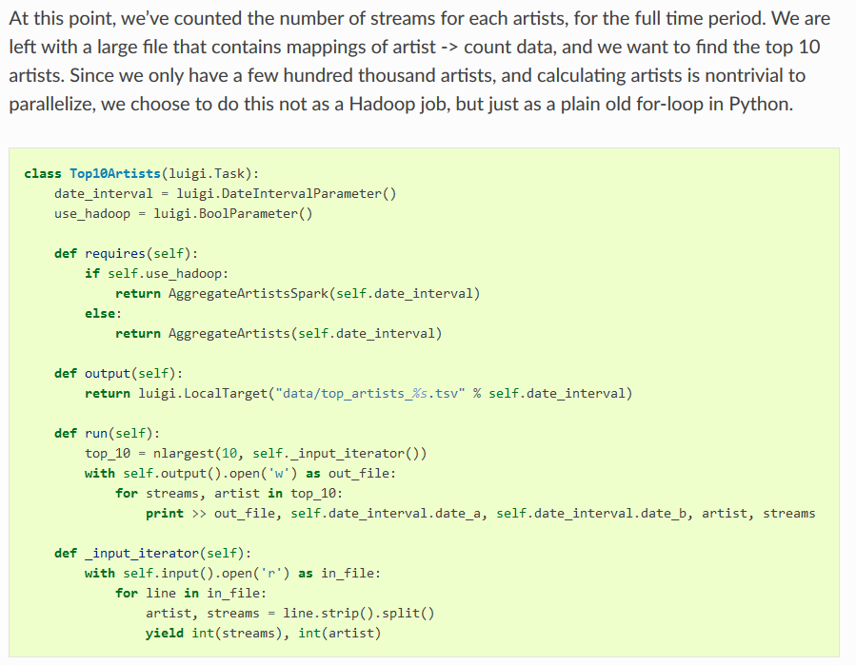
Step 2 – Find the Top Artists

